Slide 1
Language Models
Human Language from a Computational Perspective
April 11, 2018

Slide 2

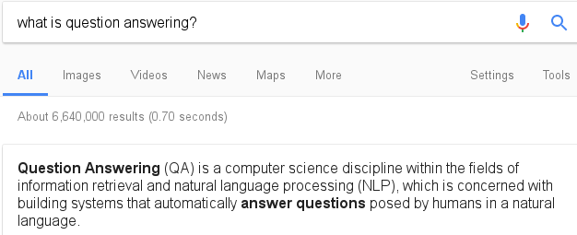
Natural Language Processing
Algorithms that understand or generate human language
Automatic summarization is the process of reducing a text document with a computer program in order to create a summary that retains the most important points of the original document. Technologies that can make a coherent summary take into account variables such as length, writing style and syntax. Automatic data summarization is part of machine learning and data mining. The main idea of summarization is to find a representative subset of the data, which contains the information of the entire set. Summarization technologies are used in a large number of sectors in industry today. An example of the use of summarization technology is search engines such as Google. Other examples include document summarization, image collection summarization and video summarization. Document summarization, tries to automatically create a representative summary or abstract of the entire document, by finding the most informative sentences. Similarly, in image summarization the system finds the most representative and important (or salient) images. Similarly, in consumer videos one would want to remove the boring or repetitive scenes, and extract out a much shorter and concise version of the video.
Automatic summarization: reducing text with a computer to retain the most important points.

Slide 3
Statistical Language Model
How likely is each of these sentences?
please make me a cup of coffee
please make me a cup of butter
please make me a cup of bottle
please make me a cup of dream
please make me a cup of please

Slide 4


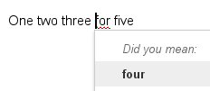
Uses of Language Models
Typing prediction
Spelling correction
recognize speech
wreck a nice beach
Speech recognition
Many more

Slide 5
Algorithm
Instructions for manipulating data.
Can get parameters as input.
Returns an output.
input
Algorithm
output

Slide 6
Pseudocode
Notation to describe algorithms.
Not a programming language, but clear enough for humans.

Slide 7
Algorithm to find maximum
Find the largest number in a list.
[3, 1, 4, 16, 0, 2] → 16
[1, 2, 1, 1, 1] → 2
[-3, -2, 0, -1] → 0

Slide 8
Algorithm to find maximum
max(L): ▹ L is a list of numbers
m ← L[1] ▹ assign the first number to m
i ← 2 ▹ assign 2 to i
while i ≤ len(L): ▹ repeat while i is at most len(L)
if L[i] > m: ▹ the i’th number is larger than m
m ← L[i] ▹ assign the i’th number to m
i ← i + 1 ▹ increase i by 1
return m ▹ output is the value of m

Slide 9
Algorithm to find maximum
Comments
max(L): ▹ L is a list of numbers
m ← L[1] ▹ assign the first number to m
i ← 2 ▹ assign 2 to i
while i ≤ len(L): ▹ repeat while i is at most len(L)
if L[i] > m: ▹ the i’th number is larger than m
m ← L[i] ▹ assign the i’th number to m
i ← i + 1 ▹ increase i by 1
return m ▹ output is the value of m

Slide 10
Algorithm to find maximum
Function definition
max(L): ▹ L is a list of numbers
m ← L[1] ▹ assign the first number to m
i ← 2 ▹ assign 2 to i
while i ≤ len(L): ▹ repeat while i is at most len(L)
if L[i] > m: ▹ the i’th number is larger than m
m ← L[i] ▹ assign the i’th number to m
i ← i + 1 ▹ increase i by 1
return m ▹ output is the value of m

Slide 11
Algorithm to find maximum
Parameters
max(L): ▹ L is a list of numbers
m ← L[1] ▹ assign the first number to m
i ← 2 ▹ assign 2 to i
while i ≤ len(L): ▹ repeat while i is at most len(L)
if L[i] > m: ▹ the i’th number is larger than m
m ← L[i] ▹ assign the i’th number to m
i ← i + 1 ▹ increase i by 1
return m ▹ output is the value of m
A function can get more than one parameter, but max gets just one

Slide 12
Algorithm to find maximum
max(L): ▹ L is a list of numbers
m ← L[1] ▹ assign the first number to m
i ← 2 ▹ assign 2 to i
while i ≤ len(L): ▹ repeat while i is at most len(L)
if L[i] > m: ▹ the i’th number is larger than m
m ← L[i] ▹ assign the i’th number to m
i ← i + 1 ▹ increase i by 1
return m ▹ output is the value of m
Variables

Slide 13
Algorithm to find maximum
max(L): ▹ L is a list of numbers
m ← L[1] ▹ assign the first number to m
i ← 2 ▹ assign 2 to i
while i ≤ len(L): ▹ repeat while i is at most len(L)
if L[i] > m: ▹ the i’th number is larger than m
m ← L[i] ▹ assign the i’th number to m
i ← i + 1 ▹ increase i by 1
return m ▹ output is the value of m
Assignment

Slide 14
Algorithm to find maximum
max(L): ▹ L is a list of numbers
m ← L[1] ▹ assign the first number to m
i ← 2 ▹ assign 2 to i
while i ≤ len(L): ▹ repeat while i is at most len(L)
if L[i] > m: ▹ the i’th number is larger than m
m ← L[i] ▹ assign the i’th number to m
i ← i + 1 ▹ increase i by 1
return m ▹ output is the value of m
Indexing

Slide 15
Algorithm to find maximum
max(L): ▹ L is a list of numbers
m ← L[1] ▹ assign the first number to m
i ← 2 ▹ assign 2 to i
while i ≤ len(L): ▹ repeat while i is at most len(L)
if L[i] > m: ▹ the i’th number is larger than m
m ← L[i] ▹ assign the i’th number to m
i ← i + 1 ▹ increase i by 1
return m ▹ output is the value of m
Function call
The function len returns the number of elements (length) of a list

Slide 16
Algorithm to find maximum
max(L): ▹ L is a list of numbers
m ← L[1] ▹ assign the first number to m
i ← 2 ▹ assign 2 to i
while i ≤ len(L): ▹ repeat while i is at most len(L)
if L[i] > m: ▹ the i’th number is larger than m
m ← L[i] ▹ assign the i’th number to m
i ← i + 1 ▹ increase i by 1
return m ▹ output is the value of m
Loop

Slide 17
Algorithm to find maximum
max(L): ▹ L is a list of numbers
m ← L[1] ▹ assign the first number to m
i ← 2 ▹ assign 2 to i
while i ≤ len(L): ▹ repeat while i is at most len(L)
if L[i] > m: ▹ the i’th number is larger than m
m ← L[i] ▹ assign the i’th number to m
i ← i + 1 ▹ increase i by 1
return m ▹ output is the value of m
Condition

Slide 18
Algorithm to find maximum
max(L): ▹ L is a list of numbers
m ← L[1] ▹ assign the first number to m
i ← 2 ▹ assign 2 to i
while i ≤ len(L): ▹ repeat while i is at most len(L)
if L[i] > m: ▹ the i’th number is larger than m
m ← L[i] ▹ assign the i’th number to m
i ← i + 1 ▹ increase i by 1
return m ▹ output is the value of m
Output

Slide 19
Algorithm to find maximum
Indentation
max(L): ▹ L is a list of numbers
m ← L[1] ▹ assign the first number to m
i ← 2 ▹ assign 2 to i
while i ≤ len(L): ▹ repeat while i is at most len(L)
if L[i] > m: ▹ the i’th number is larger than m
m ← L[i] ▹ assign the i’th number to m
i ← i + 1 ▹ increase i by 1
return m ▹ output is the value of m

Slide 20
Running the algorithm
max(L): L = [3, 1, 4, 16, 0, 2]
m ← L[1] m
i ← 2 i
while i ≤ len(L):
if L[i] > m:
m ← L[i]
i ← i + 1
return m

Slide 21
Running the algorithm
max(L): L = [3, 1, 4, 16, 0, 2]
m ← L[1] m
i ← 2 i
while i ≤ len(L):
if L[i] > m:
m ← L[i]
i ← i + 1
return m

Slide 22
Running the algorithm
max(L): L = [3, 1, 4, 16, 0, 2]
m ← L[1] m = 3
i ← 2 i
while i ≤ len(L):
if L[i] > m:
m ← L[i]
i ← i + 1
return m

Slide 23
Running the algorithm
max(L): L = [3, 1, 4, 16, 0, 2]
m ← L[1] m = 3
i ← 2 i = 2
while i ≤ len(L):
if L[i] > m:
m ← L[i]
i ← i + 1
return m

Slide 24

Running the algorithm
max(L): L = [3, 1, 4, 16, 0, 2]
m ← L[1] m = 3
i ← 2 i = 2
while i ≤ len(L): len(L) = 6
if L[i] > m: 2 ≤ 6
m ← L[i]
i ← i + 1
return m

Slide 25

Running the algorithm
max(L): L = [3, 1, 4, 16, 0, 2]
m ← L[1] m = 3
i ← 2 i = 2
while i ≤ len(L): L[i] = L[2] = 1
if L[i] > m: 1 > 3
m ← L[i]
i ← i + 1
return m

Slide 26
Running the algorithm
max(L): L = [3, 1, 4, 16, 0, 2]
m ← L[1] m = 3
i ← 2 i = 3
while i ≤ len(L):
if L[i] > m:
m ← L[i]
i ← i + 1
return m

Slide 27
Running the algorithm
max(L): L = [3, 1, 4, 16, 0, 2]
m ← L[1] m = 3
i ← 2 i = 3
while i ≤ len(L): len(L) = 6
if L[i] > m: 3 ≤ 6
m ← L[i]
i ← i + 1
return m

Slide 28
Running the algorithm
max(L): L = [3, 1, 4, 16, 0, 2]
m ← L[1] m = 3
i ← 2 i = 3
while i ≤ len(L): L[i] = L[3] = 4
if L[i] > m: 4 > 3
m ← L[i]
i ← i + 1
return m

Slide 29
Running the algorithm
max(L): L = [3, 1, 4, 16, 0, 2]
m ← L[1] m = 4
i ← 2 i = 3
while i ≤ len(L): L[i] = L[3] = 4
if L[i] > m:
m ← L[i]
i ← i + 1
return m

Slide 30
Running the algorithm
max(L): L = [3, 1, 4, 16, 0, 2]
m ← L[1] m = 4
i ← 2 i = 4
while i ≤ len(L):
if L[i] > m:
m ← L[i]
i ← i + 1
return m

Slide 31
Running the algorithm
max(L): L = [3, 1, 4, 16, 0, 2]
m ← L[1] m = 4
i ← 2 i = 4
while i ≤ len(L): len(L) = 6
if L[i] > m: 4 ≤ 6
m ← L[i]
i ← i + 1
return m

Slide 32
Running the algorithm
max(L): L = [3, 1, 4, 16, 0, 2]
m ← L[1] m = 4
i ← 2 i = 4
while i ≤ len(L): L[i] = L[4] = 16
if L[i] > m: 16 > 4
m ← L[i]
i ← i + 1
return m

Slide 33
Running the algorithm
max(L): L = [3, 1, 4, 16, 0, 2]
m ← L[1] m = 16
i ← 2 i = 4
while i ≤ len(L): L[i] = L[4] = 16
if L[i] > m:
m ← L[i]
i ← i + 1
return m

Slide 34
Running the algorithm
max(L): L = [3, 1, 4, 16, 0, 2]
m ← L[1] m = 16
i ← 2 i = 5
while i ≤ len(L):
if L[i] > m:
m ← L[i]
i ← i + 1
return m

Slide 35
Running the algorithm
max(L): L = [3, 1, 4, 16, 0, 2]
m ← L[1] m = 16
i ← 2 i = 5
while i ≤ len(L): len(L) = 6
if L[i] > m: 5 ≤ 6
m ← L[i]
i ← i + 1
return m

Slide 36
Running the algorithm
max(L): L = [3, 1, 4, 16, 0, 2]
m ← L[1] m = 16
i ← 2 i = 5
while i ≤ len(L): L[i] = L[5] = 0
if L[i] > m: 0 > 16
m ← L[i]
i ← i + 1
return m

Slide 37
Running the algorithm
max(L): L = [3, 1, 4, 16, 0, 2]
m ← L[1] m = 16
i ← 2 i = 6
while i ≤ len(L):
if L[i] > m:
m ← L[i]
i ← i + 1
return m

Slide 38
Running the algorithm
max(L): L = [3, 1, 4, 16, 0, 2]
m ← L[1] m = 16
i ← 2 i = 6
while i ≤ len(L): len(L) = 6
if L[i] > m: 6 ≤ 6
m ← L[i]
i ← i + 1
return m

Slide 39
Running the algorithm
max(L): L = [3, 1, 4, 16, 0, 2]
m ← L[1] m = 16
i ← 2 i = 6
while i ≤ len(L): L[i] = L[6] = 2
if L[i] > m: 2 > 16
m ← L[i]
i ← i + 1
return m

Slide 40
Running the algorithm
max(L): L = [3, 1, 4, 16, 0, 2]
m ← L[1] m = 16
i ← 2 i = 7
while i ≤ len(L):
if L[i] > m:
m ← L[i]
i ← i + 1
return m

Slide 41
Running the algorithm
max(L): L = [3, 1, 4, 16, 0, 2]
m ← L[1] m = 16
i ← 2 i = 7
while i ≤ len(L): len(L) = 6
if L[i] > m: 7 ≤ 6
m ← L[i]
i ← i + 1
return m

Slide 42
Running the algorithm
max(L): L = [3, 1, 4, 16, 0, 2]
m ← L[1] m = 16
i ← 2 i = 7
while i ≤ len(L):
if L[i] > m: output: 16
m ← L[i]
i ← i + 1
return m
Notes:
Question: what do I need to change to make this an algorithm to find the minimum?

Slide 43
Finding index of maximum
Index of largest number in a list.
[3, 1, 4, 16, 0, 2] → 4
[1, 2, 1, 1, 1] → 2
[-3, -2, 0, -1] → 3

Slide 44
Finding index of maximum
argmax(L): ▹ L is a list of numbers
a ← 1 ▹ index of the first element
i ← 2 ▹ index of the second element
while i ≤ len(L): ▹ repeat while i is at most len(L)
if L[i] > L[a]: ▹ i’th number is larger than a’th
a ← i ▹ assign i to a
i ← i + 1 ▹ increase i by 1
return a ▹ output: index of largest number

Slide 45
Back to language models
Given a list of tokens, predict the most likely token to follow.
please make me a cup of tea
Notes:
You just solved this task automatically with your brains. It’s still rather vague, but it will be clearer soon.

Slide 46
Tokenization
We represent a string:
“I’m late!”, he said.
As a list of tokens:
“ | I | ‘m | late | ! | “ | , | he | said | .

Slide 47
Language model algorithm
Predict the next token in the list.
please make me a cup of → coffee
one two three → four
what is your phone → number
But the list of tokens is not enough.
We also need to know the language.

Slide 48
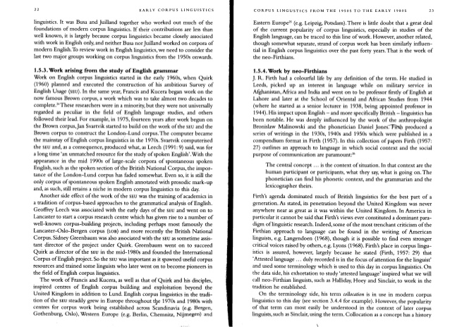
Corpora
A text corpus is used to analyze the distribution of words.

Slide 49
Counts table
To represent token counts, we map strings to numbers.
Some ready-made counts:
books.google.com/ngrams
, | 775
the | 630
. | 392
“ | 345
and | 339
a | 337
to | 277
she | 249

Slide 50
Algorithm to count words
Count all words in a tokenized corpus and return a table of counts.
[i, am, sam, .,
sam, i, am., →
i, do, not, like,
green, eggs, and, ham, .]
i | 3 | like | 1
am | 2 | green | 1
sam | 2 | eggs | 1
. | 3 | and | 1
do | 1 | ham | 1
not | 1

Slide 51
Algorithm to count words
count(L): ▹ L is a list of tokens
C1 ← [0] ▹ create a table of zeros
i ← 1 ▹ assign 1 to i
while i ≤ len(L): ▹ repeat while i is at most len(L)
t ← L[i] ▹ get token at position i
C1[t] ← C1[t] + 1 ▹ increase count for t by 1
i ← i + 1 ▹ increase i by 1
return C1 ▹ output is the counts table

Slide 52
Algorithm to count words
count(L): ▹ L is a list of tokens
C1 ← [0] ▹ create a table of zeros
i ← 1 ▹ assign 1 to i
while i ≤ len(L): ▹ repeat while i is at most len(L)
t ← L[i] ▹ get token at position i
C1[t] ← C1[t] + 1 ▹ increase count for t by 1
i ← i + 1 ▹ increase i by 1
return C1 ▹ output is the counts table
Using a word as an index to a table

Slide 53
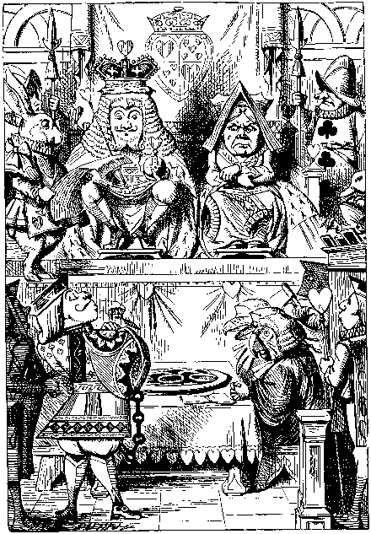
Word counts
, | 775
the | 630
. | 392
“ | 345
and | 339
a | 337
to | 277
she | 249
Example counts from Alice's Adventures in Wonderland (1866) by Lewis Carroll

Slide 54
Unigram Language Model
Easiest: always predict the most frequent token:
I wish I
, | 775
the | 630
. | 392
“ | 345
and | 339
a | 337
to | 277
she | 249
I wish I ,
C1 =
(Unigram counts)
C1[,] = 775
C1[the] = 630

Slide 55
Bigram counts
We can also count
bigrams (pairs of words)
, the | 530
and the | 320
. “ | 89
she said ... | 65
I ‘m | 20
I do | 10
C2 =
C2[and, the] = 320
C2[she, said] = 65

Slide 56
Bigram Language Model
Look only at the last token to predict the next:
I wish I
I ‘m | 20
I do | 10
I ‘ll | 10
I ‘ve | 10
I should | 8
I must | 7
I think | 7
I wish | 6
I wish I ‘m
C2[I, ·] =
(Bigram counts starting with I)
C2[I, ‘m] = 20
C2[I, do] = 10

Slide 57
Trigram Language Model
Look at the two last
tokens to predict the next:
I wish I
I wish I could
C3[wish, I, could] = 20
C3[wish, I, had] = 10
wish I could | 20
wish I had | 10
C3[wish, I, ·] =
(Trigram counts starting with wish I)

Slide 58
n-gram Language Model
Look at the n − 1 last
tokens to predict the next:
I wish I
I wish I could
C3[I, wish, I, could] = 2
C3[I, wish, I, had] = 2
C4[I, wish, I, ·] =
(4-gram counts starting with I wish I):
I wish I could | 2
I wish I had | 2

Slide 59
Algorithm to count n-grams
count(L, n): ▹ L: list of tokens, n: a number
C ← [0] ▹ create a table of zeros
i ← 1 ▹ assign 1 to i
while i ≤ len(L) − n + 1: ▹ repeat while i is at most len(L) − n + 1
T ← L[i, ..., i + n − 1] ▹ get n tokens starting at i
C[T] ← C[T] + 1 ▹ increase count for T by 1
i ← i + 1 ▹ increase i by 1
return C ▹ output is the counts table

Slide 60
Algorithm to count n-grams
count(L, n): ▹ L: list of tokens, n: a number
C ← [0] ▹ create a table of zeros
i ← 1 ▹ assign 1 to i
while i ≤ len(L) − n + 1: ▹ repeat while i is at most len(L) − n + 1
T ← L[i, ..., i + n − 1] ▹ get n tokens starting at i
C[T] ← C[T] + 1 ▹ increase count for T by 1
i ← i + 1 ▹ increase i by 1
return C ▹ output is the counts table
Getting several elements from a list

Slide 61
Algorithm to count n-grams
count(L, n): ▹ L: list of tokens, n: a number
C ← [0] ▹ create a table of zeros
i ← 1 ▹ assign 1 to i
while i ≤ len(L) − n + 1: ▹ repeat while i is at most len(L) − n + 1
T ← L[i, ..., i + n − 1] ▹ get n tokens starting at i
C[T] ← C[T] + 1 ▹ increase count for T by 1
i ← i + 1 ▹ increase i by 1
return C ▹ output is the counts table
Using an n-gram as an index to a table

Slide 62
Unigram algorithm
unigram(L, C1): ▹ L: tokens, C1: unigram counts
return argmax(C1) ▹ token with highest count

Slide 63
Unigram algorithm
unigram(L, C1): ▹ L: tokens, C1: unigram counts
return argmax(C1) ▹ token with highest count
Function call

Slide 64
Unigram algorithm
unigram(L, C1): ▹ L: tokens, C1: unigram counts
return argmax(C1) ▹ token with highest count
Ignores L and always predicts the same word...

Slide 65
Bigram algorithm
bigram(L, C2): ▹ L: tokens, C2: bigram counts
k ← len(L) ▹ length of L
t ← L[k] ▹ last token in L
return argmax(C2[t, ·]) ▹ bigram with highest count,
▹ among the bigrams starting with t

Slide 66
Bigram algorithm
bigram(L, C2): ▹ L: tokens, C2: bigram counts
k ← len(L) ▹ length of L
t ← L[k] ▹ last token in L
return argmax(C2[t, ·]) ▹ bigram with highest count,
▹ among the bigrams starting with t
Getting part of the table

Slide 67
Trigram algorithm
trigram(L, C3): ▹ L: tokens, C3: trigram counts
k ← len(L) ▹ length of L
T ← L[k − 1, k] ▹ last two tokens in L
return argmax(C3[T, ·]) ▹ trigram with highest count,
▹ among the trigrams starting with T

Slide 68
General n-gram algorithm
ngram(L, n, Cn): ▹ L: tokens, Cn: n-gram counts
k ← len(L) ▹ length of L
T ← L[k − n + 2, ..., k] ▹ last n − 1 tokens in L
return argmax(Cn[T, ·]) ▹ n-gram with highest count,
▹ among the n-grams starting with T
This can replace unigram, bigram and trigram algorithms: just use n=1, n=2 or n=3

Slide 69
Text prediction algorithm
predict(L, n, Cn, m): ▹ L: tokens, Cn: n-gram counts,
▹ m: total wanted number of words
P ← L ▹ start with words given as input
while len(P) < m: ▹ repeat until we have m words
P[len(P) + 1] ← ngram(P, n, Cn) ▹ add next word
return P ▹ output is list of words including input

Slide 70
n-gram models comparison
Unigram | , , , , , , , , , , , , , , , , , , , , , , , , , , , , , , , , , , , , , , , , , , , , , , , , , , , , , , , ,
Bigram | then she went on it had been running about in her head ! the garden , who was now , for some of them !
Trigram | all of a good deal frightened at the top of her sister , who was gently brushing away some dead leaves that had fallen into a tree a few minutes , it was the white rabbit , who was now about two feet high .
4-gram | the first thing i 've got to do , so alice soon began talking to herself . `` dinah 'll miss me very much to-night , i should think ! '' ( dinah was the cat
5-gram | and so it was indeed ! she was now only ten inches high , and her face brightened up at the thought that she was now about two feet high and was going on shrinking rapidly .

Slide 71
Back-off
n-gram models quickly become too sparse.
Whenever I wish I
does not occur in Alice in Wonderland: cannot use 5-gram.
If no match is found, use a smaller n:
To predict the next token, back-off to 4-grams:
Whenever I wish I could
I wish I could | 2
I wish I had | 2

Slide 72
Trigram with Backoff to Bigram
trigram-backoff-bigram(L, C2, C3): ▹ L: tokens,
k ← len(L) ▹ C2: bigram counts, C3: trigram counts
if C3[L[k − 1, k], ·]) is empty : ▹ not found
return argmax(C2[L[k], ·]) ▹ use bigram
else: ▹ trigram found
return argmax(C3[L[k − 1, k], ·]) ▹ use trigram

Slide 73
Trigram with Backoff to Bigram
trigram-backoff-bigram(L, C2, C3): ▹ L: tokens,
k ← len(L) ▹ C2: bigram counts, C3: trigram counts
if C3[L[k − 1, k], ·]) is empty : ▹ not found
return argmax(C2[L[k], ·]) ▹ use bigram
else: ▹ trigram found
return argmax(C3[L[k − 1, k], ·]) ▹ use trigram
if/else condition

Slide 74
Trigram with Full Backoff
trigram-backoff(L, C): ▹ L is a list of tokens,
k ← len(L) ▹ C is the list [C1, C2, C3]:
i ← 3 ▹ unigram, bigram, trigram counts
while C[i][L[k − i + 2, ..., k], ·] is empty:
i ← i − 1 ▹ i-gram not found, try i − 1
return argmax(C[i][L[k − i + 2, ..., k], ·])

Slide 75
References
Google Ngram Viewer: books.google.com/ngrams
Alice's Adventures in Wonderland on Wikisource: en.wikisource.org/wiki/Alice's_Adventures_in_Wonderland_(1866)
n-grams: en.wikipedia.org/wiki/N-gram

Slide 76
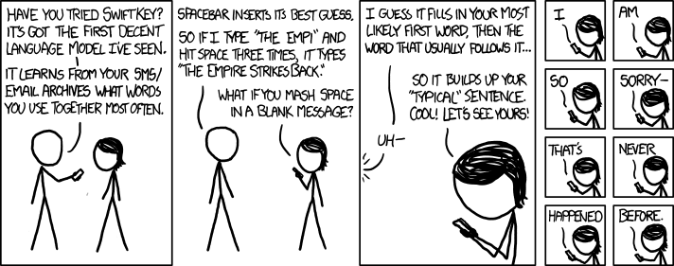
xkcd.com/1068

